Slide 1

FINANCE PREDICTION TRACKER : Using Regression ML
By
Krishna Dongre (22106089)
Tanveer Angane (22106057)
Siddharth Chaurasiya (22106060)
Anish Gawade (22106109)
Under the Guidance of
Prof. Kanchan Wankhede

Slide 2
Outline
INTRODUCTION
LITERATIVE SURVEY OF THE EXISTING SYSTEMS
LIMITATIONS OF THE EXISTING SYSTEM
PROBLEM STATEMENT
PROPOSED SYSTEM DESIGN
FRAMEWORK / ALGORITHM
TECHNOLOGIES STACK FOR PROPOSED SYSTEM
DETAILS OF DATABASE / INPUT OF THE SYSTEM
IMPLEMENTAION
CONCLUSION
REFERENCES

Slide 3
INTRODUCTION
In today's fast-paced and data-driven world, financial management is more crucial than ever.
A finance dashboard app emerges as an indispensable tool, offering a centralized platform for real-time monitoring, data visualization, and predictive analytics.
By streamlining the process of financial data collection and reporting, our app enhance efficiency, reduce errors, and provide valuable insights into future trends
Noticing the limitations of current tools and the need for more accurate, scalable solutions inspired me to develop a better prediction system.
Challenges faced by investors and analysts highlighted the need for innovation in financial forecasting.

Slide 4
This project aims to address the following key objectives:
Data Visualization: Displays key performance indicators (KPIs) and financial data using various charts and tables.
Machine Learning Predictions: Implement a predictions page that utilizes regression.js to forecast future revenue trends based on historical data.
Enhance Accuracy: Use advanced regression techniques to improve prediction precision.
Improve Scalability: Build a system that efficiently handles large datasets.
Increase Accessibility: Create a user-friendly interface for users of all technical levels.

Slide 5
LITERATIVE SURVEY
SR. NO.
PAPER NAME
AUTHORS
PROS
CONS
1) The article provides a detailed overview of machine learning applications in financial market prediction, reviewing 57 key studies and categorizing methods and variables.
2) It identifies gaps, such as the lack of data from developing markets, pointing to areas for future research.
1) The focus on North American market data may limit the findings' applicability to other regions.
2) Emphasis on popular methods like SVMs and neural networks may overlook emerging techniques.
Machine learning techniques applied to financial market prediction
Bruno Miranda Henrique
Vinicius Amorim Sobreiro
1.

Slide 6
LITERATIVE SURVEY
 |  | Kartik Baliyan Shubham Vishnoi Dr. Swati Sharma
SR. NO.
PAPER NAME
AUTHORS
PROS
CONS
NLP can help users sift through large volumes of financial messages to identify relevant information, improving personal financial management and efficiency.
The need to access and analyze users' messages raises significant privacy issues, requiring strict user consent and secure handling of personal information.
Financial Tracker using NLP
2.

Slide 7
LITERATIVE SURVEY
 |  | Alev Dilek Aydin
SR. NO.
PAPER NAME
AUTHORS
PROS
CONS
1). Effective Nonlinear: The use of Artificial Neural Networks allows for sophisticated nonlinear
modeling, which capture complex relationships in financial data
2) Early-Warning System: The study's development of an early-warning system using ANNs can provide timely alerts about potential financial crises
Data Dependency
2). Black-Box Nature: ANNs are often criticized for their "black-box" nature, meaning the decision-making process within the model is not easily interpretable.
Prediction of Financial Crisis with Artificial Neural Network: An
Empirical Analysis on Turkey
3.

Slide 8
LITERATIVE SURVEY
 | Financial indicators tracker application (FIT) | Khairul Shafee Kalid Muhammad Zulhilmi Bachok Md Akhir Mohd Sharif
SR. NO.
1) Automated Financial Analysis: The application saves time by automatically calculating key financial ratios from multiple data sources.
2) Better Investment Decisions: It helps users easily compare company performance, aiding in more informed stock choices.
PAPER NAME
AUTHORS
PROS
CONS
Data Integration Issues: Combining data from various providers may lead to inconsistencies and impact accuracy.
Limited Analysis Scope: Focusing on only ten financial ratios may not provide a complete financial overview for all users.
4.

Slide 9
LIMITATIONS OF EXISTING SYSTEM
Data Integration: Many systems struggle to integrate data from multiple sources, leading to fragmented financial insights.
Real-Time Processing: Some systems lack the ability to process and analyze real-time data effectively, leading to delayed insights.
Customization Limits: Many systems offer limited customization, preventing businesses from tailoring tools to their specific needs.
Predictive Accuracy: Predictive capabilities may fall short due to oversimplified models or inadequate data inputs, resulting in less accurate forecasts.

Slide 10
PROBLEM STATEMENT:
Real-time Data Tracking: Many businesses struggle to track their financial metrics in real-time, leading to delayed insights and decision-making.
Predictive Analysis: There is a need for tools that not only display current financial data but also predict future trends, helping businesses to plan strategically.
User-friendly Interface: Existing financial tools can be complex and difficult to use, necessitating a solution that is both powerful and user-friendly.
Cost-effective Deployment: High deployment and maintenance costs can be a barrier for small to medium-sized businesses looking to implement sophisticated financial tools.

Slide 11
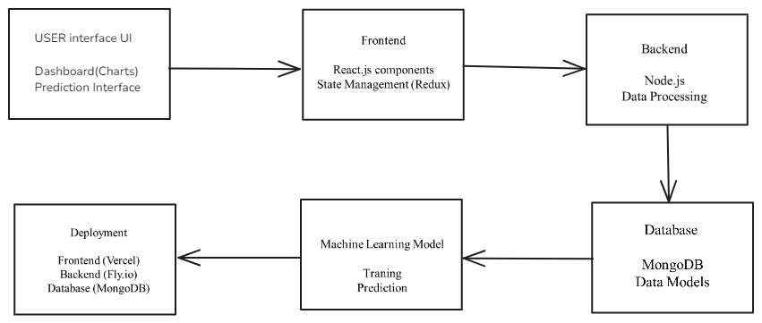
SYSTEM DESIGN:

Slide 12
FRAMEWORK / ALGORITHM
Regression ML : Regression in machine learning is widely used in finance to predict outcomes like revenue, stock prices, and sales by analyzing historical data and relevant factors. It helps in making data-driven decisions by modeling relationships between variables. Common types include linear regression for revenue prediction and logistic regression for risk assessment. While effective, these models assume linear relationships and can be sensitive to outliers.

Slide 13
TECHNOLOGY USED:
Front End:
React JS
CSS
Material UI
Redux toolkit
Back End:
Node JS
Express JS
Mongoose (Database)
Regression ML (Library)

Slide 14
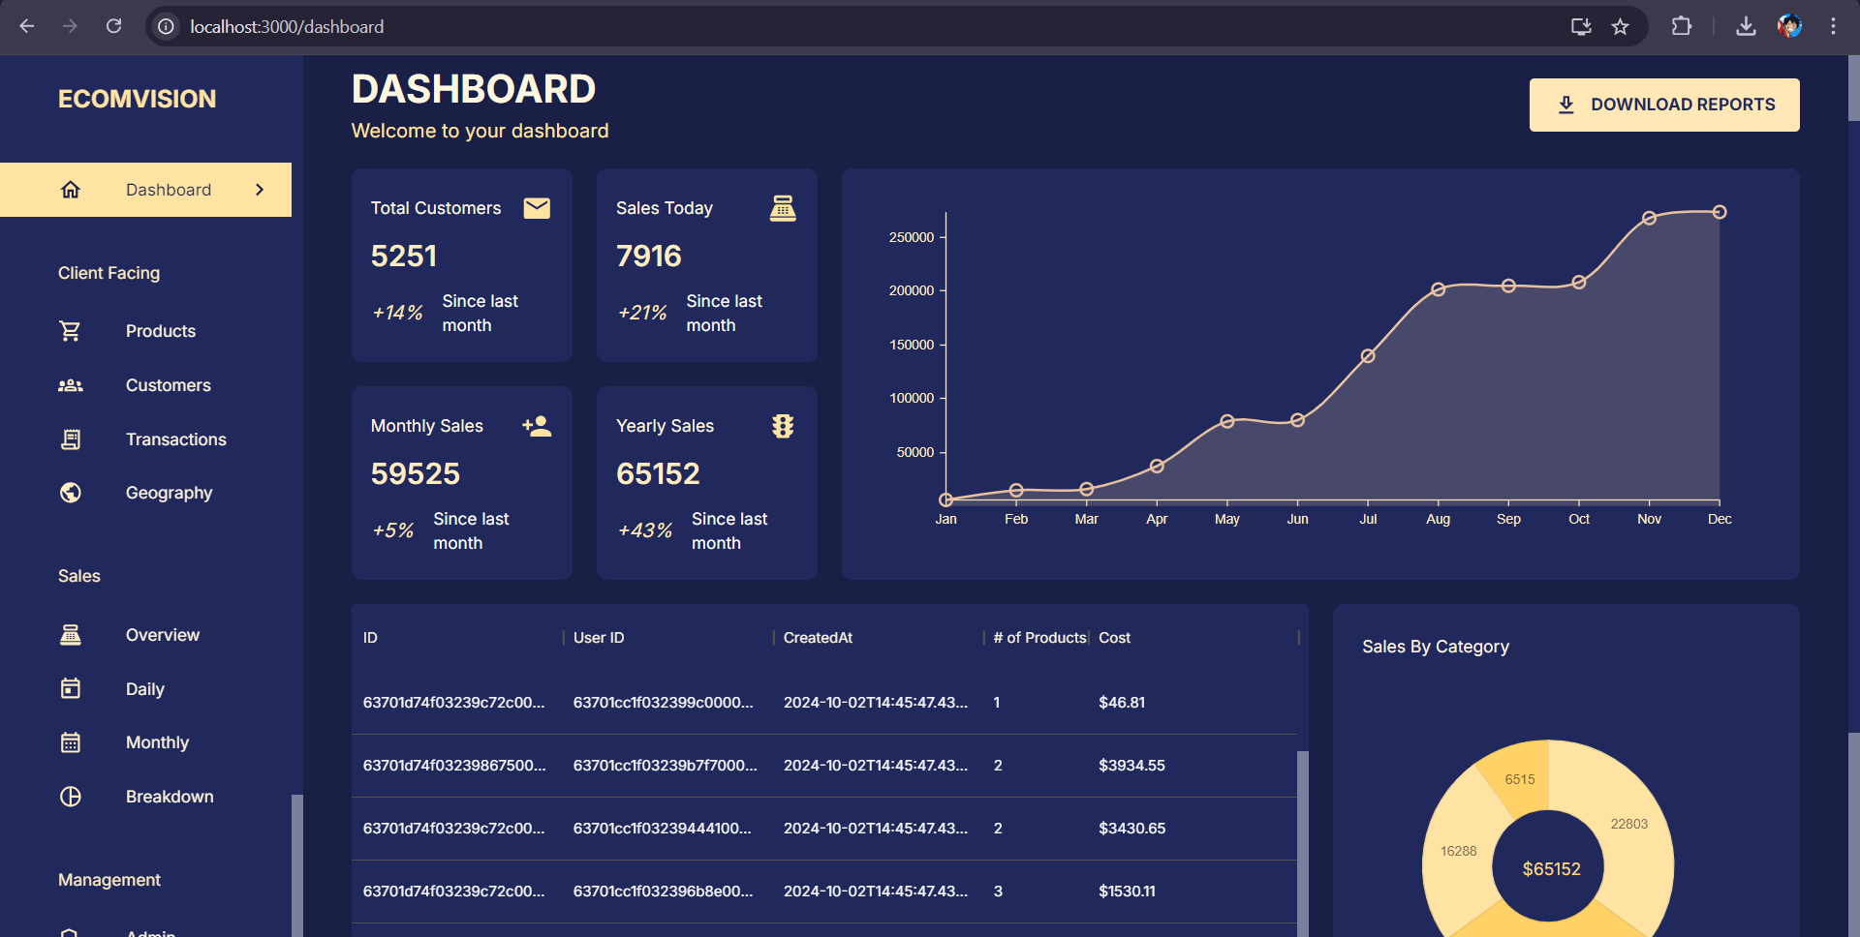
DASBOARD

Slide 15
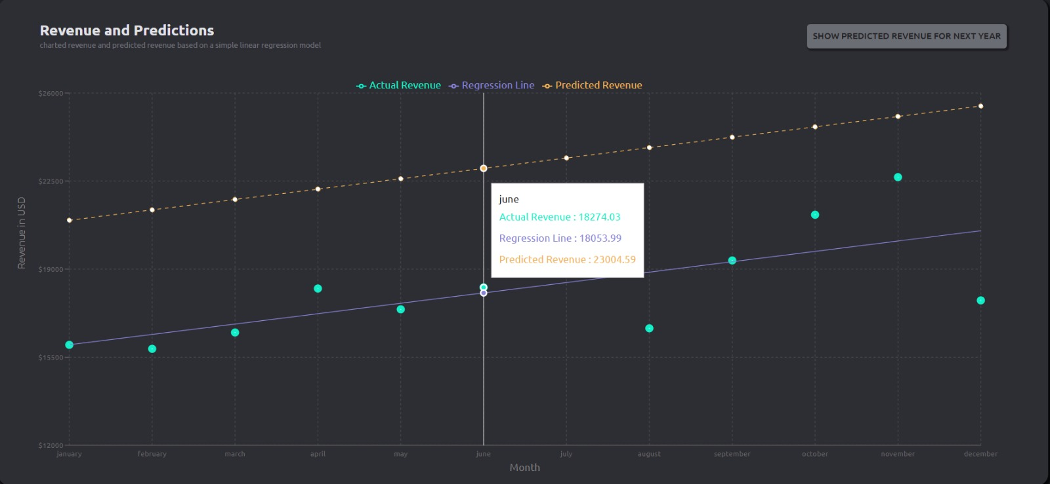
PREDICTION

Slide 16
REFERENCE
Henrique, B. M., Sobreiro, V. A., & Kimura, H. (2019). Literature review: Machine learning techniques applied to financial market prediction. Expert Systems with Applications, 124, 226-251.[1]
Baliyan, Kartik, Shubham Vishnoi, and Swati Sharma. "Financial Tracker using NLP." International Journal of Engineering and Management Research 11.3 (2021): 124-125.[2]
Aydin, Alev Dilek, and Seyma Caliskan Cavdar. "Prediction of financial crisis with artificial neural network: an empirical analysis on Turkey." International journal of financial research 6.4 (2015): 36.[3]
Kalid, Khairul Shafee, Muhammad Zulhilmi Bachok, and Md Akhir Mohd Sharif. "Financial indicators tracker application (FIT)." 2012 International Conference on Computer & Information Science (ICCIS). Vol. 1. IEEE, 2012.[4]

Slide 17
CONCLUSION:
The Finance tracker addresses these challenges by providing a real-time, interactive platform for financial data visualization and predictive analysis. By leveraging modern web technologies and free hosting solutions, it offers a cost-effective, powerful tool for businesses of all sizes.

Slide 18
Thank You!!!

